Slide 1
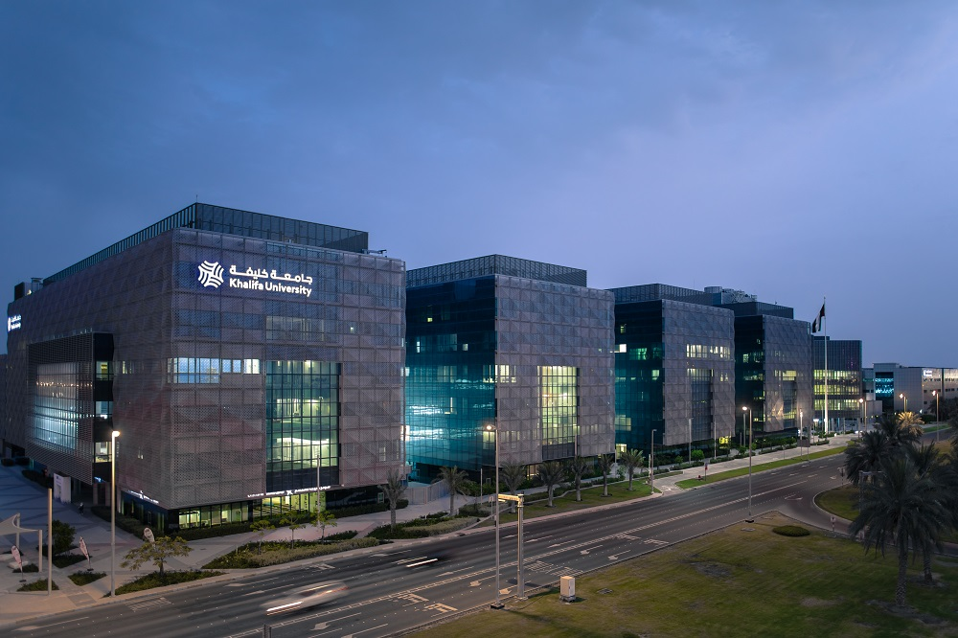
Admission Interview for Ph.D. Studies at Khalifa University
AHSAN HANIF Mechanical Engineering

Slide 2


CONTENT OUTLINE
Academic Background
Research Interests
Research Works
Future Goals
Motivation for Khalifa University

Slide 3




Academic Background
Matriculation
[2013-2015]
Percentage: 94
Intermediate (Pre-Engineering) [2015-2017]
Percentage: 94.27
B.Sc. Mechanical Engineering
[2017-2021]
CGPA: 3.924/4.0

Slide 4

Research Interests
1
Renewable Alternative Fuels and their Production, Storage, Utilization and Associated concerns.
2
Multi-objective Response Surface Methodology (RSM) based optimization for optimal performance and emission characteristics of SI and CI engines.
3
Enviro-Economic analysis of renewable alternative fuels in comparison to the conservative fuels.

Slide 5

Research Works:
Core Challenges and Prospects of Methanol Utilization, Prediction and Optimization for Sustainable Environment [Book Chapter]
IntechOpen October 2023
Key Points:
The core challenges that are currently occurring for methanol utilization, as a renewable alternative fuel, in SI engines were targeted.
The detailed analysis of such challenges was performed for their clear and detailed understanding.
The desired solutions for these challenges were derived and highlighted in the mentioned chapter.
Several prediction and optimization techniques were defined for the deriving the optimal conditions for SI engines while utilizing methanol as an alternative fuel.

Slide 6
Research Works (Cont.):
Multi-objective RSM-based optimization of Diesel-Diethyl Ether blends in Diesel Engine to achieve Sustainable development goals [Research Article]
Energy Conversion and Management: X [Under Review]
Key Points:
Two engine parameters i.e., Engine Speed and Diesel Diethyl Ether blends were targeted.
The combined impact of the above mentioned parameters was observed on the performance and emission characteristics using ANOVA and 3D surface plots.
RSM based optimization has been performed for the evaluation of optimal conditions for the utilization of Diesel Diethyl Ether blends in CI engines.
The achievement of Sustainable Development Goals (SDG 12: Responsible Consumption) was highlighted as a major objective of this study.

Slide 7
Research Works (Cont.):
Multi-objective optimization-based enviro-economic evaluation of hydroxy-diesel mixture in Compression-Ignition Engine [Research Article]
Heliyon [Under Review]
Key Points:
Two engine parameters i.e., Engine Speed and Diesel Hydroxy gas blends were targeted.
The combined impact of the above mentioned parameters was observed on the performance and emission characteristics using ANOVA and 3D surface plots.
RSM based optimization has been performed for the evaluation of optimal conditions for the utilization of Diesel Hydroxy gas blends in CI engines.
Enviro-economic analysis for Diesel Hydroxy gas has been performed.
The achievement of Sustainable Development Goals (SDG 13: Climate Action and SDG 15: Life on Land) was highlighted as a major objective of this study.

Slide 8


Future Goals
Environmentalist by nature and passionate for promotion and development of green energy solutions globally.
Postgraduate research on techno-economic aspects of modern energy conversion and storage technologies.
Research on material sciences, computational engineering, data science, or management and policy.
Professional career as a research scientist in energy related research and development at a state-of-the-art research facility.
Participation in energy industry enabling clean energy production for developing and under-developed countries.

Slide 9

Motivation for Khalifa University
Well reputed and high ranked university (QS rank 181, 28th in Asia, 1st in UAE)
State-of-the-art research facilities and significant research output
Impressive student-faculty ratio of 8:1 and cultural diversity because of students from different nationalities
Fully funded graduate study opportunities for international students
UAE Energy Strategy 2050 (44% clean energy in the energy mix)
A chance to act upon my passion for renewable energy development and promotion
Bright career prospects in research and development in clean energy sector

Slide 10




THANK YOU!
Ahsan Hanif
ahsanhanif1000@gmail.com
+92-316-487-9620

